Slide 1

SAFESTEP
Stop the risk.
Explain the decision.
EXISTING MVP
REAL CODE CHANGES
SIMULATED PAYMENTS
Zhumabay Dias · Temirlan Satybaldy · Beknur Ualikhanuly · Saparbek Bekzat · Sagidolla Beibars
Notes:
Suggested speaker: Beibars. Suggested duration: 0:35.
Hello. We are the SafeStep team. Our project addresses payment fraud at the confirmation stage. In SIS 10–11 we tested the existing prototype, fixed two weaknesses, implemented a client change request, and prepared a commercial proposal. Today we will show real evidence from our product.

Slide 2
Part 1 / Find the weaknesses
Baseline testing guided which improvements we chose.
10 passed
6
4
Initial backend suite
Issues identified
Technical debt items
SELECTED TO FIX
ISS-06 Missing explicit agent reason
ISS-04 Failed warning has no retry
OPEN LIMITATIONS
Authentication / authorization · trusted-device proof · state guard · dependency audit
Notes:
Suggested speaker: Beknur. Suggested duration: 0:55.
First, we tested the current SafeStep product. The original backend suite passed ten tests. We documented six issues and four technical debt items. For this assignment we selected two improvements: we required a real operator reason, and we added warning error recovery. Other security limitations remain open and are not presented as fixed.

Slide 3
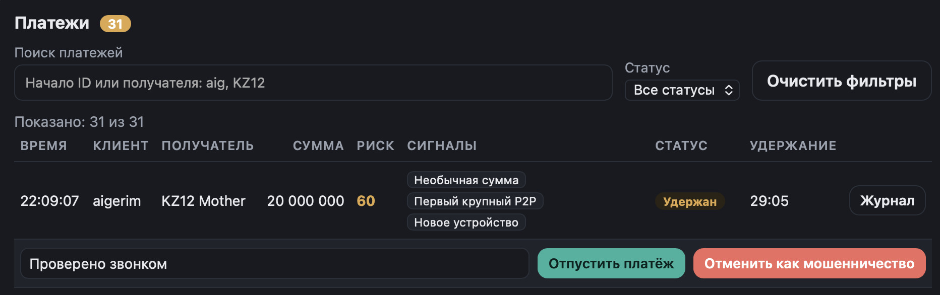
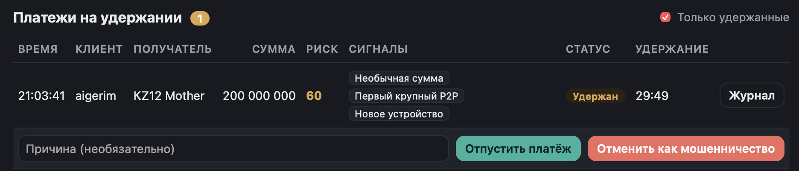
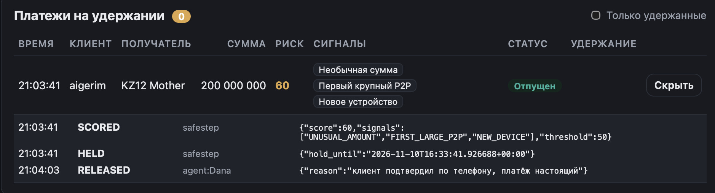
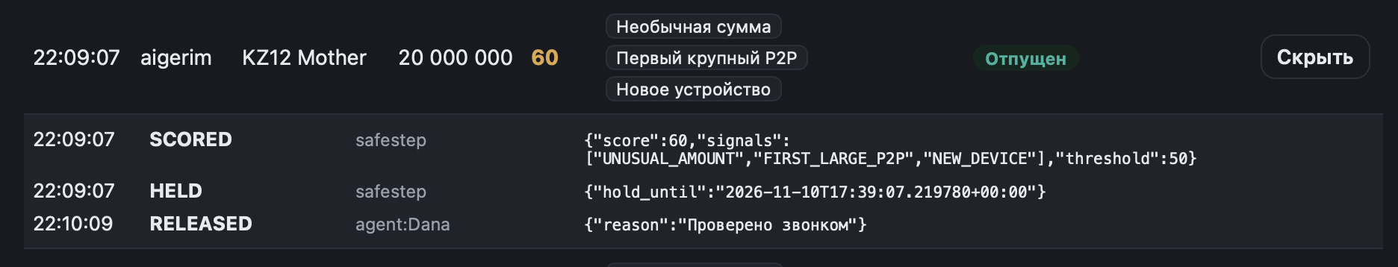
Part 2 / An audit reason must be real
ISS-06 - remove automatic fallback reasons; reject empty input in UI and API.
BEFORE · OPTIONAL INPUT
AFTER · OPERATOR-ENTERED REASON
BEFORE AUDIT · PREDEFINED STATEMENT
AFTER AUDIT · SAME INPUT SAVED
Result: valid reason preserved; blank / whitespace-only reasons rejected (HTTP 422).
Notes:
Suggested speaker: Temirlan. Suggested duration: 1:00.
Before our improvement, the operator reason field was optional. When it was empty, the system inserted a predefined sentence in the audit log. This could give a misleading record. We changed the frontend and API: a reason is required. The after screenshots show an entered reason, "Проверено звонком", and the exact same reason in the released payment audit. We also tested blank input; it is rejected with HTTP 422. The screenshots do not prove that a phone call really happened.

Slide 4
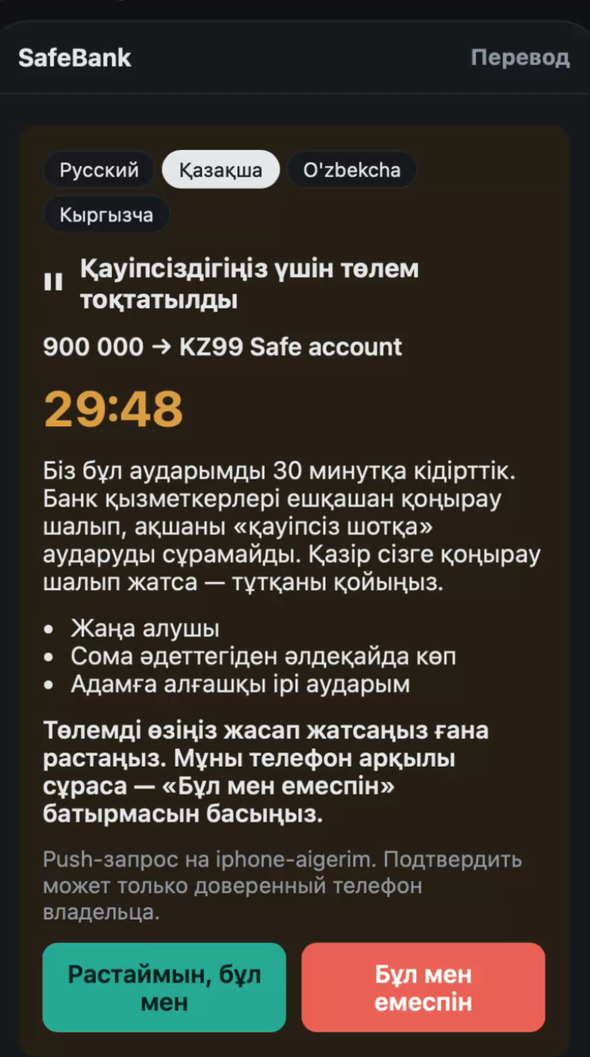
Part 2 / Recover when warnings fail
ISS-04 - a failed request should show an error, not silently keep old content.
BEFORE: WARNING CONTROL FAILURE
AFTER: RECOVERY FLOW
1 Localized warning load error appears
2 Retry sends another warning GET request
3 Warning returns after service recovery
Previous UI video demonstrates unchanged warning text; the recording alone does not verify backend state.
SEPARATE 3-SECOND VIDEO
Notes:
Suggested speaker: Dias. Suggested duration: 0:45.
In the old version, a warning request could fail without a visible error or recovery action. This short recording shows the old interface not updating when a language control is pressed. We added a localized error and a Retry button. After the backend was available, Retry restored the warning in our manual demonstration. The video itself does not show the backend state.

Slide 5
Part 3 / Respond to a client change
CR-01: Payment Prefix Search and Status Filtering.
8 h
USER STORY
“As a contact-centre operator, I want to find payments by the beginning of a customer ID or payee and filter them by status.”
Estimated effort
40,000 ₸
Incremental change estimate
Case-insensitive beginning-of-field matching
All / Held / Sent / Released / Cancelled
No new backend endpoint.
Client-side filtering only.
No database migration.
Clear Filters, counts and no-results message
Notes:
Suggested speaker: Bekzat. Suggested duration: 0:50.
For Part 3, we created a realistic academic client request. A bank operator needs to find a payment without scanning the full queue. We prepared a Change Request and Impact Analysis. We estimated eight person-hours and forty thousand tenge for this incremental feature. These are planning assumptions, not measured actual costs. The feature uses the data already loaded by the frontend, so it does not add a backend API.

Slide 6
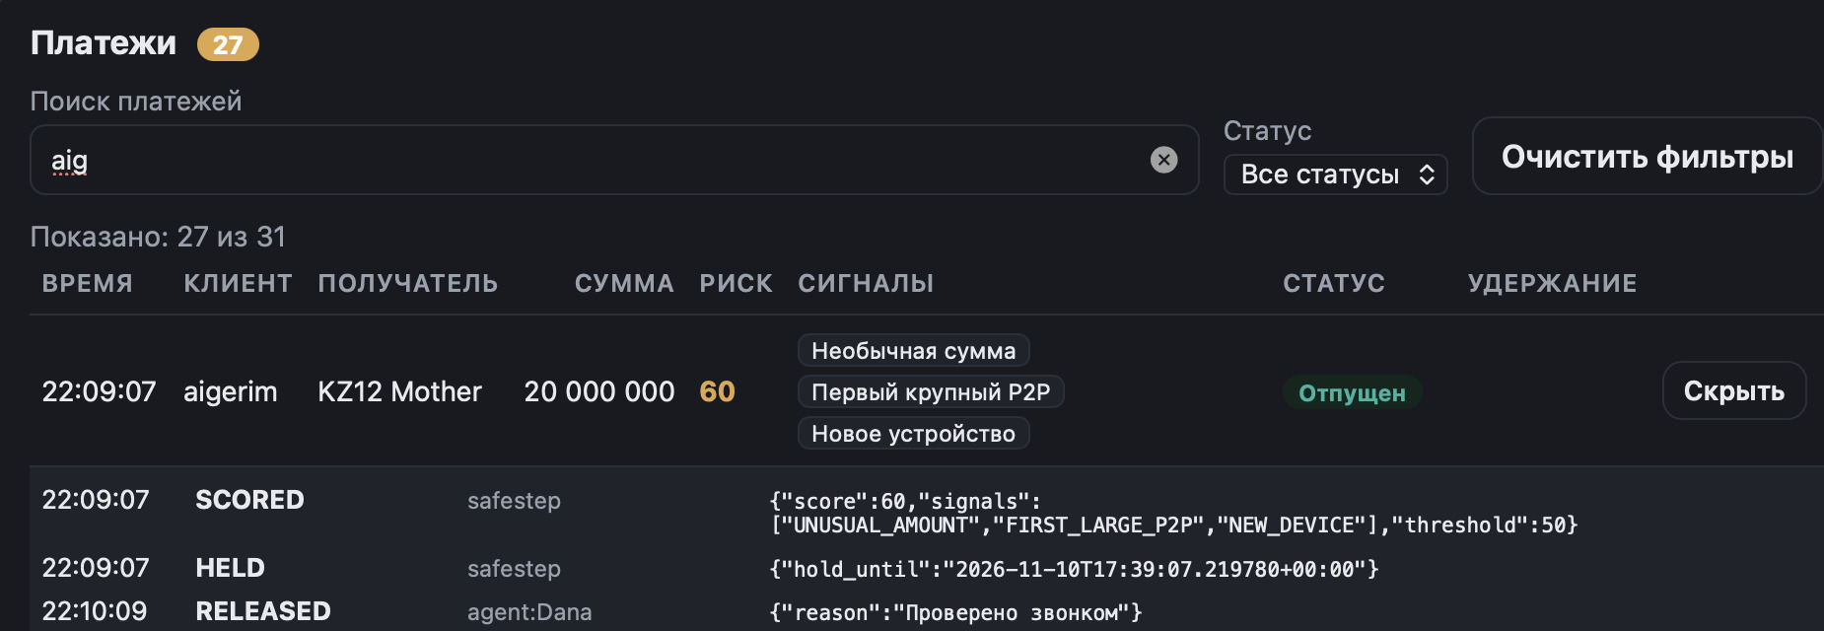
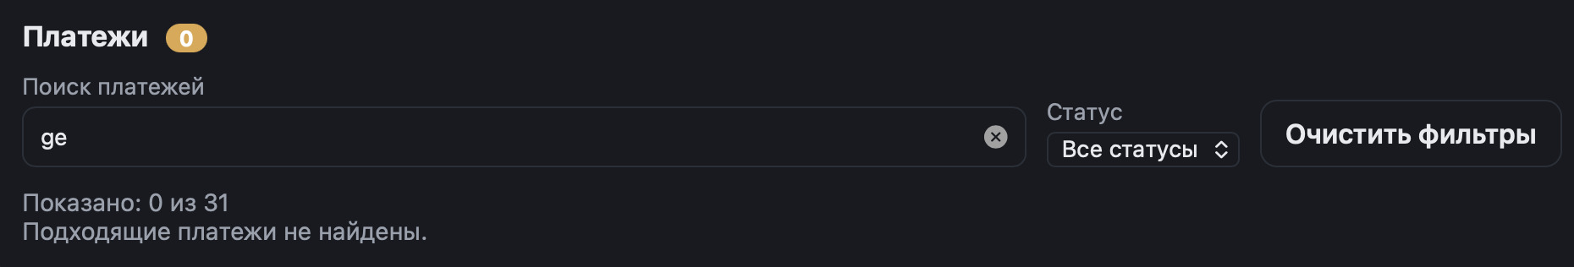
Part 4 / Prefix means prefix
The final search rule checks the beginning of the whole customer ID or payee field.
POSITIVE · “AIG”
NEGATIVE · “GE”
“aig” → 27 / 31 records | “ge” → 0 / 31 records
Notes:
Suggested speaker: Dias. Suggested duration: 1:00.
We implemented the feature in the actual SafeStep contact-centre page. It searches at the beginning of customer ID or payee, not inside words. For example, aig matches aigerim. But ge is not a prefix of aigerim, so it is rejected. In our demonstration data, aig shows twenty-seven of thirty-one payments, while ge shows zero. Both fields are checked, so the number depends on the available records.

Slide 7
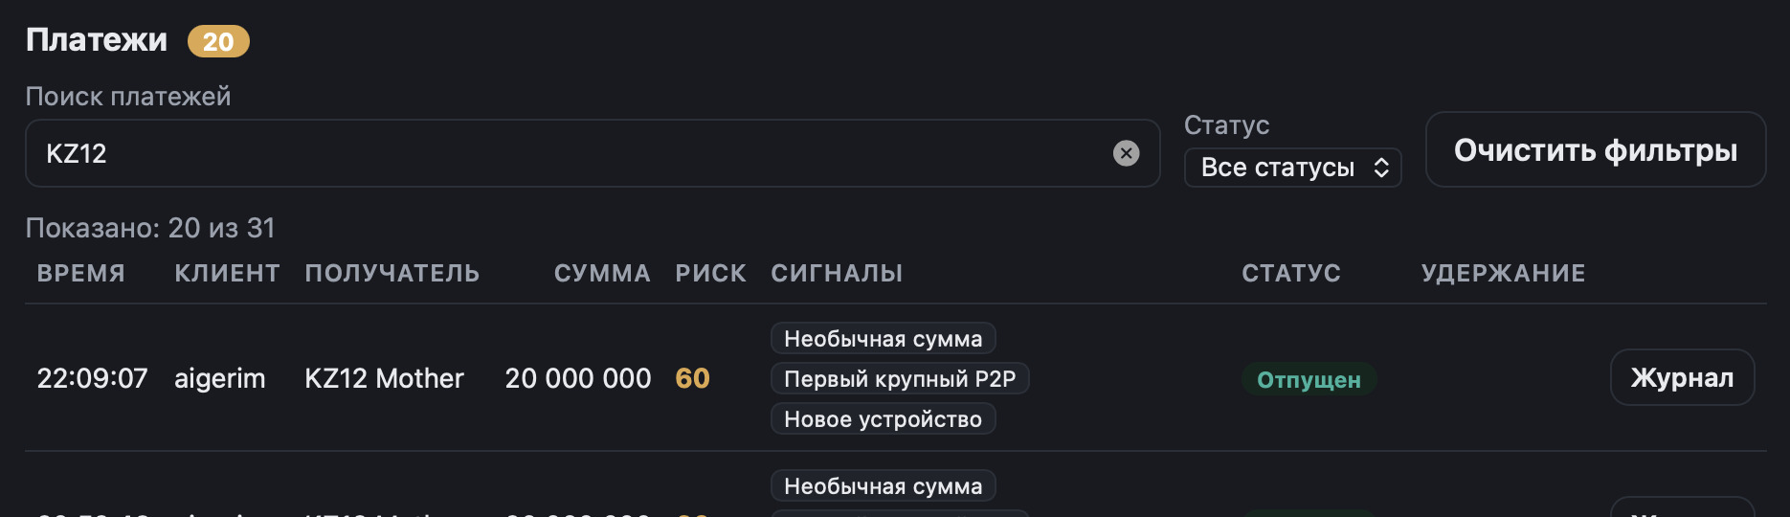
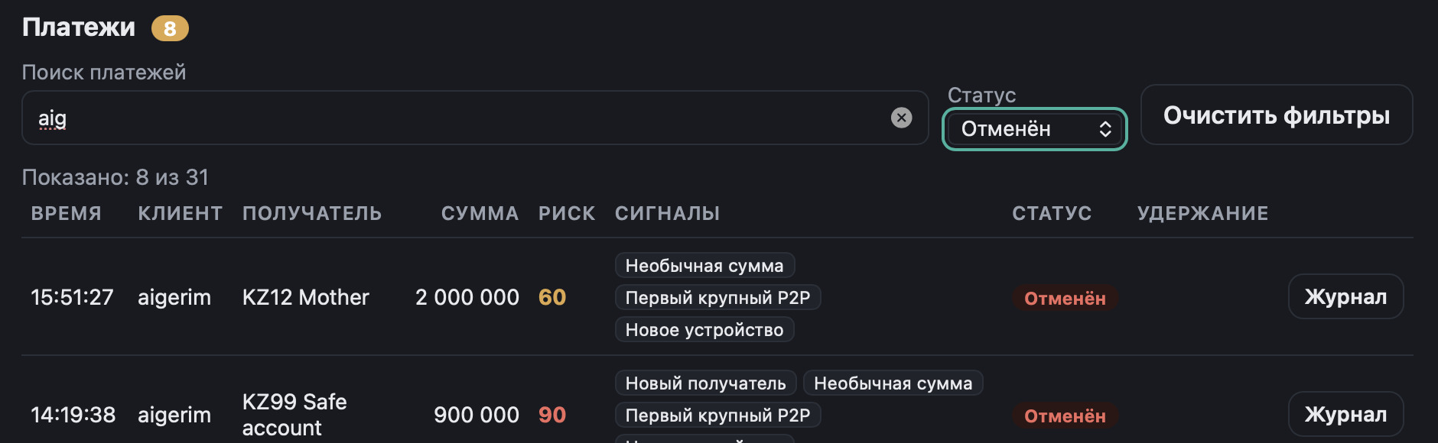
Part 4 / Combine text and status
The result must satisfy both filters; the UI displays matching and total counts.
PAYEE PREFIX
COMBINED SEARCH + STATUS
KZ12
aig + Cancelled
20 of 31 payments
8 of 31 payments
Notes:
Suggested speaker: Dias. Suggested duration: 0:50.
The same feature also supports filtering by payee and payment status. The KZ12 prefix shows twenty of thirty-one matching records. Combining aig with Cancelled shows eight matching records. We also added Clear Filters, localized control labels, and a result count. These screenshots show the real interface, not a static mockup.

Slide 8
Part 4 / Verify the new behavior
Separate automated results - not a single combined test suite.
14 / 14
18 / 18
PASS
New frontend filter tests
Backend suite after Part 2
Frontend build + lint
FINAL CR-01 EXAMPLES
aig
aigerim
MATCH
ge
aigerim
NO MATCH
KZ12
KZ12 Mother
MATCH
Mother
KZ12 Mother
NO MATCH
Notes:
Suggested speaker: Temirlan. Suggested duration: 0:40.
We verified the final search logic with fourteen automated tests. They all passed. The backend suite from Part 2 separately passed eighteen tests, and frontend build and lint were successful. We keep these results separate because they test different code. We do not claim a complete browser test suite or production security readiness.

Slide 9
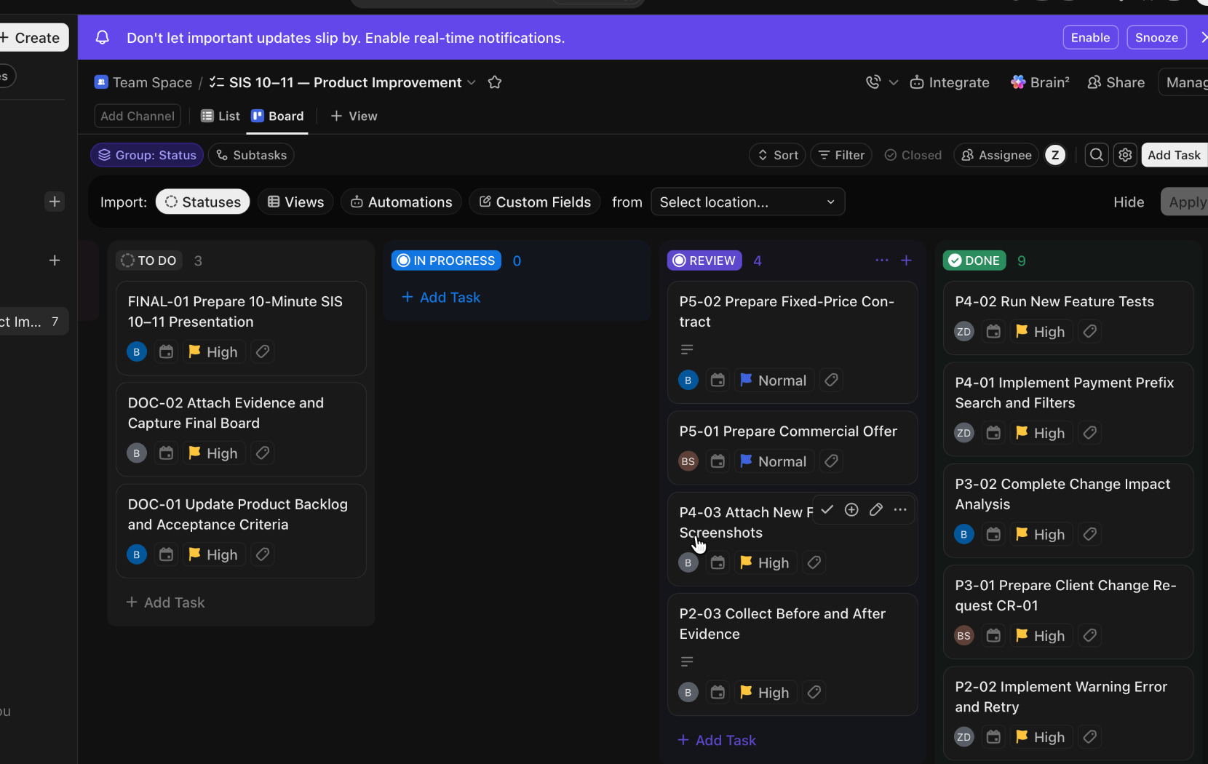
One board / Real project traceability
ClickUp links testing, fixes, change implementation, documents and remaining work.
9
Done
4
Review
3
To Do
Notes:
Suggested speaker: Beibars. Suggested duration: 0:45.
We organized the SIS 10–11 work in a separate ClickUp list, without deleting earlier sprint records. The board contains sixteen tasks covering all five assignment parts and final documentation. At the time of this screenshot, nine were Done, four were in Review and three were To Do. This makes progress and remaining actions visible to the team.

Slide 10
Part 5 / Commercial offer
A fixed-price academic proposal to adapt the existing MVP for one demonstration pilot.
6 weeks
1,380,000 ₸
Estimated adaptation period
Total fixed price
30 days
240 person-hours × 5,000 KZT
Defect-correction warranty
= 1,200,000 KZT base estimate
+ 15% contingency (180,000 KZT)
CR-01 already included - no double billing
Notes:
Suggested speaker: Beknur. Suggested duration: 0:55.
For Part 5, we prepared a commercial offer for an academic potential bank client. It covers adapting the existing demo MVP, not building a production system from zero. We estimated two hundred forty person-hours at five thousand tenge per hour, plus fifteen percent contingency, for a fixed price of one million three hundred eighty thousand tenge. The duration is six weeks, with a thirty-day warranty. Our earlier business case assumed a separate future monthly licence, so we do not mix these two scenarios.

Slide 11
Part 5 / Contract and acceptance
Price, milestones and scope must match the Commercial Offer.
PAYMENT MILESTONES
30%
Kickoff
40%
Week 4 review
30%
Final acceptance
414,000 ₸
552,000 ₸
414,000 ₸
ACCEPTANCE CHECKS
Risk score and hold → customer warning → decision + audit
Mandatory agent reason, warning retry, prefix + status filtering
Working prototype, tests, instructions and known limitations delivered
Scope boundary: simulated data only · no live bank integration · production security not claimed
Notes:
Suggested speaker: Beibars. Suggested duration: 1:00.
The simplified fixed-price contract matches the offer: the same price, six-week timeline, thirty-day warranty and milestone payments of thirty, forty and thirty percent. We defined acceptance checks for the risk workflow, operator reason, warning retry, search, audit and handover. We also clearly exclude live bank integration and production security certification. Our next steps are final evidence attachment, team review, and defense rehearsal. Thank you.

